Slide 1

DECISION TREE AND RANDOM FOREST-Letter recogniztion CASE STUDY
BY TANIA DAS

Slide 2
DATASET AND TASK
DATASET:-The letters dataset contains 3116 observations, each of which corresponds to a certain image of one of the four letters A, B, P and R. The images came from 20 different fonts, which were then randomly distorted to produce the final images; each such distorted image is represented as a collection of pixels, each of which is "on" or "off". For each such distorted image, we have available certain statistics of the image in terms of these pixels, as well as which of the four letters the image is.
This dataset contains the following 17 variables:
letter = the letter that the image corresponds to (A, B, P or R)
xbox = the horizontal position of where the smallest box covering the letter shape begins.
ybox = the vertical position of where the smallest box covering the letter shape begins.
width = the width of this smallest box.
height = the height of this smallest box.
onpix = the total number of "on" pixels in the character image
xbar = the mean horizontal position of all of the "on" pixels
ybar = the mean vertical position of all of the "on" pixels
x2bar = the mean squared horizontal position of all of the "on" pixels in the image
y2bar = the mean squared vertical position of all of the "on" pixels in the image
xybar= the mean of the product of the horizontal and vertical position of all of the "on" pixels in the image.
x2ybar = the mean of the product of the squared horizontal position and the vertical position of
all of the "on" pixels
xy2bar = the mean of the product of the horizontal position and the squared vertical position of all of the "on" pixels.

Slide 3
DATASET AND PROBLEM STATEMENT
xedge = the mean number of edges (the number of times an "off" pixel is followed by an "on" pixel, or the image boundary is hit) as the image is scanned from left to right, along the whole vertical length of the image
xedgeycor = the mean of the product of the number of horizontal edges at each vertical position and the vertical position
yedge = the mean number of edges as the images is scanned from top to bottom, along the whole horizontal length of the image.
yedgexcor = the mean of the product of the number of vertical edges at each horizontal position and the horizontal position.
TASK:-One of the earliest applications of the predictive analytics methods was to automatically recognize letters,
which post office machines use to sort mail.
In this problem, you will build a Decision Tree model and Random Forest Model that uses statistics of images of four letters in the roman alphabet -- A, B, P, and R -- to predict which letter a particular image corresponds to

Slide 4
DECISION TREE:-CONCEPT
WHAT IS DECISION TREE?
Decision tree is a type of supervised learning technique (having a pre-defined target /dependent variable) that is mostly used in classification problems. It works for both categorical and continuous input and output variable. A Decision tree is a flowchart like tree structure, where each internal node denotes a test on an attribute, each branch represents an outcome of the test, and each leaf node (terminal node) holds a class label.
TYPES OF DECISION TREE
There are two main types of decision trees that are based on the target variable, i.e., categorical variable decision trees and continuous variable decision trees.
1. Categorical variable decision tree(CHAID)
A categorical variable decision tree includes categorical target variables that are divided into categories. For example, the categories can be yes or no. The categories mean that every stage of the decision process falls into one category, and there are no in-betweens.
2. Continuous variable decision tree(CART)
A continuous variable decision tree is a decision tree with a continuous target variable. For example, the income of an individual whose income is unknown can be predicted based on available information such as their occupation, age, and other continuous variables.

Slide 5
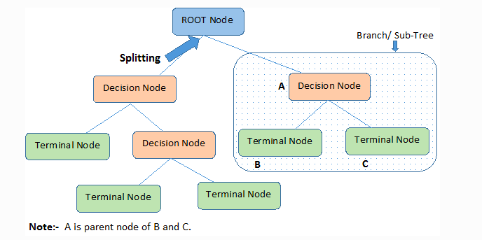
DECISION TREE:-CONCEPT
KEY TERMS IN DECISION TREE:-
Root Node: It represents the entire population or sample and this further gets divided into two or more homogeneous sets.
Splitting: It is a process of dividing a node into two or more sub-nodes.
Decision Node: When a sub-node splits into further sub-nodes, then it is called the decision node.
Leaf / Terminal Node: Nodes do not split is called Leaf or Terminal node.
Pruning: When we remove sub-nodes of a decision node, this process is called pruning. You can say the opposite process of splitting.
Branch / Sub-Tree: A subsection of the entire tree is called branch or sub-tree.
Parent and Child Node: A node, which is divided into sub-nodes is called a parent node of sub-nodes whereas sub-nodes are the child of a parent node.

Slide 6
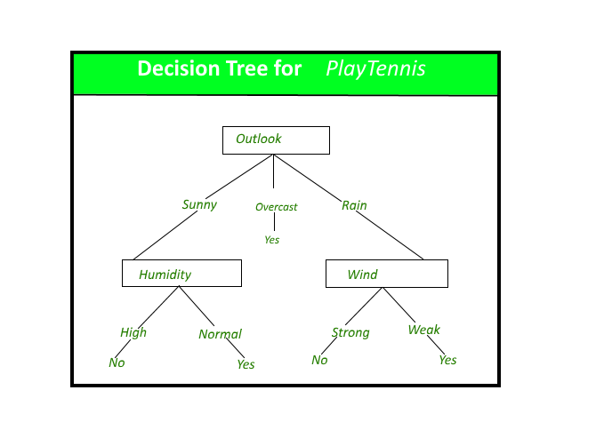
DECISION TREE:-CONCEPT
CONSTRUCTION OF DECISION TREE : A tree can be “learned” by splitting the source set into subsets based on an attribute value test. This process is repeated on each derived subset in a recursive manner called recursive partitioning. The recursion is completed when the subset at a node all has the same value of the target variable, or when splitting no longer adds value to the predictions. The construction of decision tree classifier does not require any domain knowledge or parameter setting, and therefore is appropriate for exploratory knowledge discovery. Decision trees can handle high dimensional data. In general decision tree classifier has good accuracy. Decision tree induction is a typical inductive approach to learn knowledge on classification.
DECISION TREE REPRESENTATION : Decision trees classify instances by sorting them down the tree from the root to some leaf node, which provides the classification of the instance. An instance is classified by starting at the root node of the tree, testing the attribute specified by this node, then moving down the tree branch corresponding to the value of the attribute as shown in the above figure. This process is then repeated for the subtree rooted at the new node.

Slide 7
DECISION TREE:-CONCEPT
The decision tree in above figure classifies a particular morning according to whether it is suitable for playing tennis and returning the classification associated with the particular leaf.(in this case Yes or No).
For example, the instance
(Outlook = Rain, Temperature = Hot, Humidity = High, Wind = Strong )
would be sorted down the leftmost branch of this decision tree and would therefore be classified as a negative instance. In other words we can say that decision tree represent a disjunction of conjunctions of constraints on the attribute values of instances.
(Outlook = Sunny ^ Humidity = Normal) v (Outlook = Overcast) v (Outlook = Rain ^ Wind = Weak)
ADVANTAGES OF DECISION TREE
1. Easy to read and interpret
One of the advantages of decision trees is that their outputs are easy to read and interpret without requiring statistical knowledge. For example, when using decision trees to present demographic information on customers, the marketing department staff can read and interpret the graphical representation of the data without requiring statistical knowledge.
The data can also generate important insights on the probabilities, costs, and alternatives to various strategies formulated by the marketing department.
2. Easy to prepare
Compared to other decision techniques, decision trees take less effort for data preparation. However, users need to have ready information to create new variables with the power to predict the target variable. They can also create classifications of data without having to compute complex calculations. For complex situations, users can combine decision trees with other methods.
3. Less data cleaning required
Another advantage of decision trees is that there is less data cleaning required once the variables have been created. Cases of missing values and outliers have less significance on the decision tree’s data.

Slide 8
DECISION TREE:-CONCEPT
For complex situations, users can combine decision trees with other methods.
3. Less data cleaning required
Another advantage of decision trees is that there is less data cleaning required once the variables have been created. Cases of missing values and outliers have less significance on the decision tree’s data.
DISADVANTAGES OF DECISION TREES
1. Unstable nature
One of the limitations of decision trees is that they are largely unstable compared to other decision predictors. A small change in the data can result in a major change in the structure of the decision tree, which can convey a different result from what users will get in a normal event. The resulting change in the outcome can be managed by machine learning algorithms, such as boosting and bagging.
2. Less effective in predicting the outcome of a continuous variable
In addition, decision trees are less effective in making predictions when the main goal is to predict the outcome of a continuous variable. This is because decision trees tend to lose information when categorizing variables into multiple categories.

Slide 9
DECISION TREE:-CART
CART-Classification and Regression Tree-
Decision Tree, which has continuous target/dependent variable then it is called
as Classification and Regression Tree (CART).
The CART model, usually follows the below steps
• Build a tree by splitting on variables
• To predict the outcome for an observation, follow the splits and at the end, predict the most frequent outcome.
• Does not assume a linear model
• Interpretable
When does CART Stop splitting?
There are different ways to control how many splits are generated in a CART tree
• One way is by setting a lower bound for the number of points in each subset In R, a parameter that controls this is minbucket
• The smaller it is, the more splits will be generated
• If it is too small, overfitting will occur
• If it is too large, model will be too simple and accuracy will be poo

Slide 10
DECISION TREE:-CART
The ‘CP’ parameter
• ‘cp’ stands for ‘complexity parameter’
• If a model, has too many splits then it is bad for generalization, hence we penalize the model
for its complexity
• If we pick a large value of cp, we won’t make too many splits in the model because we pay an
additional price for every split that outweighs decrease in ‘error’
• If we pick a small value of cp, we will make splits until it no longer decreases error.

Slide 11
RANDOM FOREST:CONCEPT
What is a random forest?
A random forest is a supervised machine learning algorithm that is constructed from decision tree algorithms. This algorithm is applied in various industries such as banking and e-commerce to predict behavior and outcomes. It utilizes ensemble learning, which is a technique that combines many classifiers to provide solutions to complex problems.
A random forest algorithm consists of many decision trees. The ‘forest’ generated by the random forest algorithm is trained through bagging or bootstrap aggregating. Bagging is an ensemble meta-algorithm that improves the accuracy of machine learning algorithms.
The (random forest) algorithm establishes the outcome based on the predictions of the decision trees. It predicts by taking the average or mean of the output from various trees. Increasing the number of trees increases the precision of the outcome.
A random forest eradicates the limitations of a decision tree algorithm. It reduces the overfitting of datasets and increases precision. It generates predictions without requiring many configurations in packages.

Slide 12
WHY RANDOM FOREST
Can be used to perform both regression and classification tasks
Falls in the category of ensemble methods, where weak models are aggregated to form a reliable model
A random forest produces good predictions that can be understood easily.
It can handle large datasets efficiently.
The random forest algorithm provides a higher level of accuracy in predicting outcomes over the decision tree algorithm and logistic regression technique.
Random forests consist of multiple single trees each based on a random sample of the training data. They are typically more accurate than single decision trees. The two reasons why random forests outperform single decision trees.
Trees are unpruned- While a single decision tree like CART is often pruned, a random forest tree is fully grown and unpruned, and so, naturally, the feature space is split into more and smaller regions.
Trees are diverse- Each random forest tree is learned on a random sample, and at each node, a random set of features are considered for splitting. Both mechanisms create diversity among the trees.
In general, logistic regression performs better when the number of noise variables is less than or equal to the number of explanatory variables and random forest has a higher true and false positive rate as the number of explanatory variables increases in a dataset.

Slide 13
SOLUTION METHODOLOGY
Data Exploration
Splitting the data into train and test data
Model Building.
Model Diagnostics
Conclusions and recommendations.

Slide 14
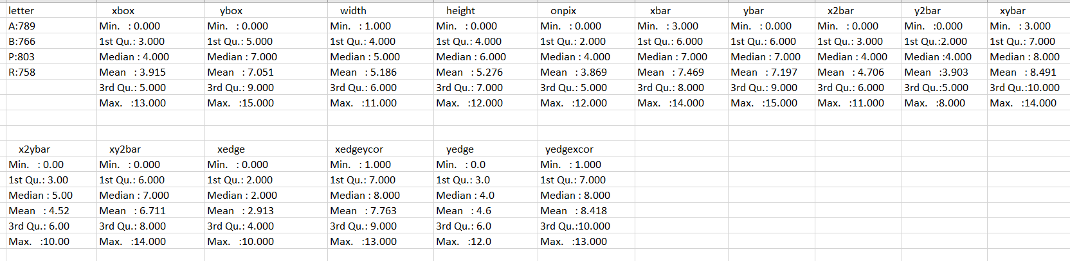
DATA EXPLORATION
There are no missing value or outliers in the dataset.
SUMMARY OF ALL THE VARIABLES

Slide 15
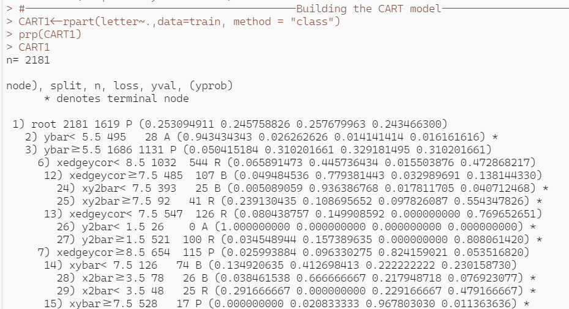
BUILDING THE MODEL
SPLITTING THE DATASET INTO TRAIN AND TEST DATASET
The entire dataset is split into train and test dataset in the ratio of 70:30.The train dataset had 2181 observations and 17 variables, while the test dataset has 935 observations and 17 variables.
DECISION TREE(CART MODEL)
Next we applied decision tree technique on the train dataset. The outcome which we derived is

Slide 16
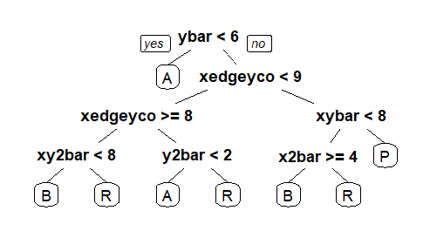
DECISION TREE(CART MODEL)-INTERPRETATION
Among the four letters (A,B,R,P)we need to predict which letter a particular image corresponds to.
The interpretation of the decision tree is given below:-
If ybar<6,it will predict A
If ybar>6 and xedgeyco<9 and xedgeyco>=8 and xy2bar<8,then it will predict B.
If ybar>6 and xedgeyco<9 and xedgeyco>=8 and xy2bar>8,then it will predict R.
If ybar>6 and xedgeyco<9 and xedgeyco<=8 and y2bar<2,then it will predict A.
If ybar>6 and xedgeyco<9 and xedgeyco<=8 and y2bar>2,then it will predict R.
If ybar>6 and xedgeyco>9 and xybar<8 and x2bar>=4,then it will predict B.
If ybar>6 and xedgeyco>9 and xybar<8 and x2bar<=4,then it will predict R.
If ybar>6 and xedgeyco>9 and xybar>8 then it will predict P.

Slide 17
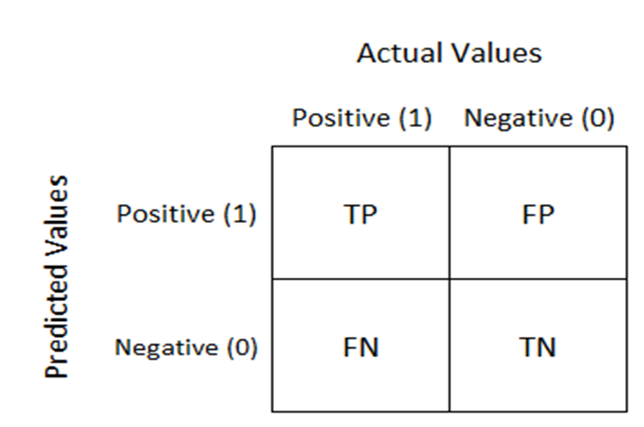
DECISION TREE-MODEL DIAGNOSTICS
Confusion Matrix is a tabulation for the predicted and actual value counts for each class. For a binary classification model like this one, where we are predicting one of the two possible values, the confusion matrix is 2x2 grid showing the predicted and actual value counts for classes 0 and 1.
A true positive is an outcome where the model correctly predicts the positive class. Similarly, a true negative is an outcome where the model correctly predicts the negative class.
A false positive is an outcome where the model incorrectly predicts the positive class. And a false negative is an outcome where the model incorrectly predicts the negative class.

Slide 18
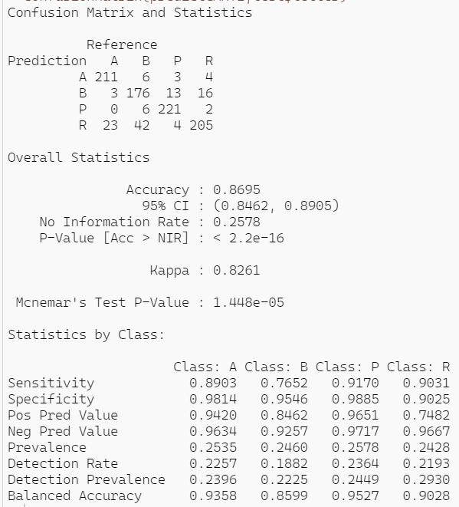
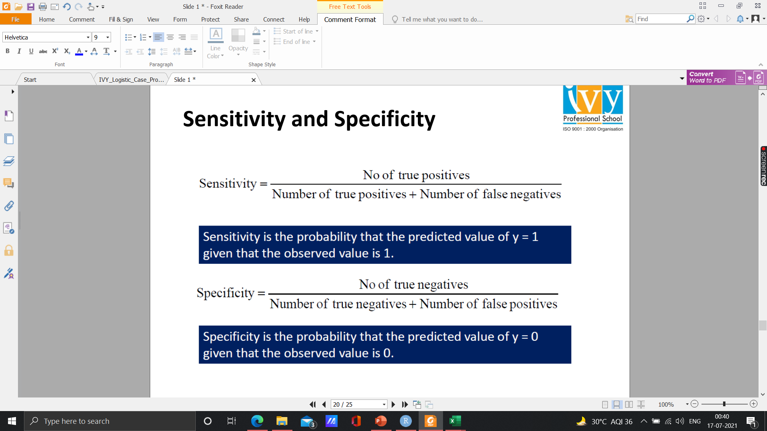
DECISION TREE-MODEL DIAGNOSTICS
SENSITIVITY AND SPECIFICITY
My accuracy is 86.95%,which is quite high. Thereby we can conclude that our model is good.

Slide 19
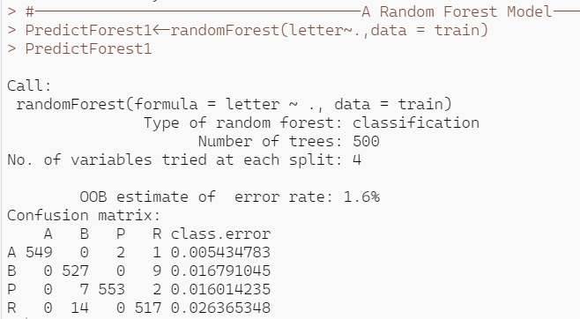
BUILDING THE MODEL
RANDOM FOREST
Next we applied Random Forest on the train dataset. The outcome which we derived is

Slide 20
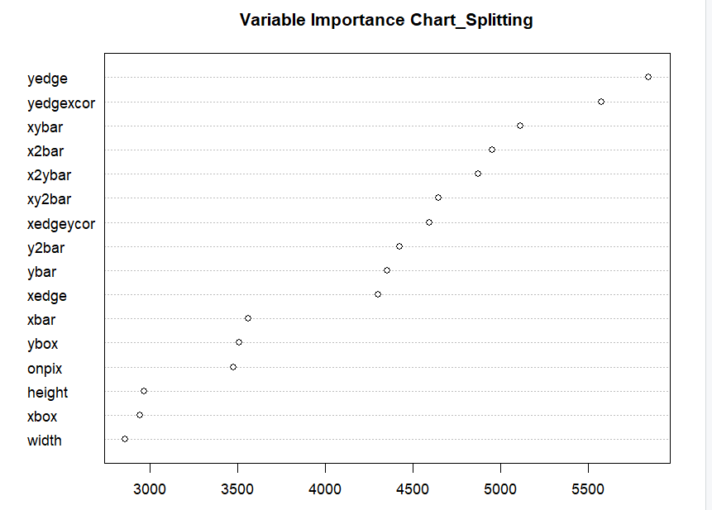
VARIABLE IMPORTANCE CHART IN RANDOM FOREST
Here, ‘yedge' variable is most important in terms of number of splits each variable measures the number of times that variable was selected for splitting (the value on the x-axis)

Slide 21
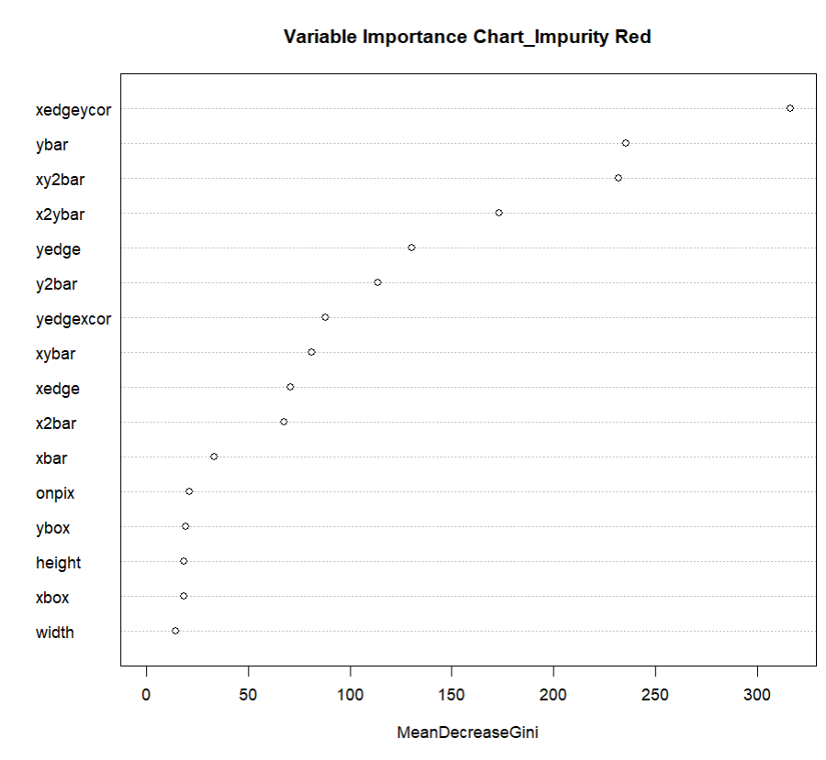
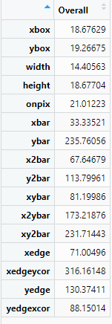
MEASURING IMPURITY IN THE RANDOM FOREST MODEL
A different metric we can look at is related to "impurity", which measures how homogenous each bucket or leaf of the tree is.
In each tree in the forest, whenever we select a variable and perform a split, the impurity is decreased.
Therefore, one way to measure the importance of a variable is to average the reduction in impurity,
taken over all the times that variable is selected for splitting in all of the trees in the forest.
Here, ‘xedgeycor' variable is most important in terms of mean reduction in impurity.

Slide 22
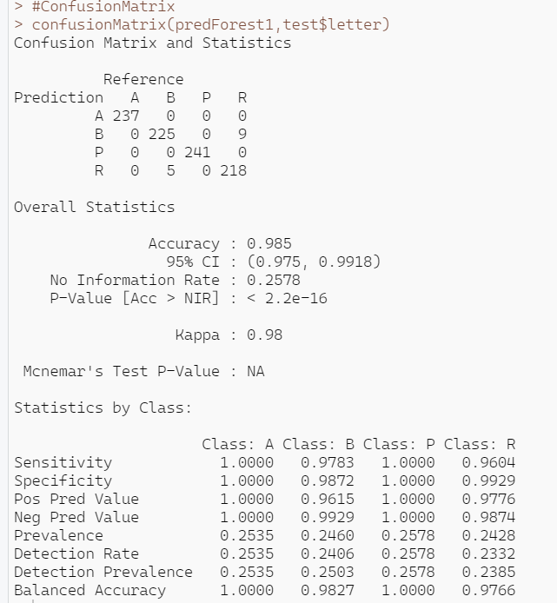
RANDOM FOREST-MODEL DIAGNOSTICS
The Random Forest derived an accuracy rate of 98.5% which quite high. Thereby I can conclude that the random forest model performed too well.

Slide 23
CONCLUSION
It was found that the variables that mattered the most in order to predict which letter a particular image corresponds to (In descending order) :
yedge
yedgexcor
xybar
x2bar
x2ybar
xy2bar
xedgeycor
y2bar
ybar
xedge
xbar
ybox
onpix
height
xbox
Width
Keeping these in mind we can almost correctly predict which roman letter among the four A,B,P,R a particular image corresponds to.

